Slide 1
Traction – A Long Read LIMS
Harriet Craven
Steve Inglis
Notes:
TODO
Pictures
Karen sad - Picture of Karen looking stressed with lots of sheets
Karen happy - with a LIMS
Karen and Craig as customers, review/ UAT/ lab UAT
NPG team
Karen quote why and how lims helps
Michelle quote why and how lims helps
Keith quote about lims traction
Speak to Naomi - external facing
Tree of Life stats
Craig quote about the multiplex spike meeting
Michelle quote about what Saphyr does
Karen quote about what Pacbio does
Quote from Karen about future ONT and Pacbio
Icon
Inbound logistics as opps -> outbound

Slide 2
WHY

Slide 3
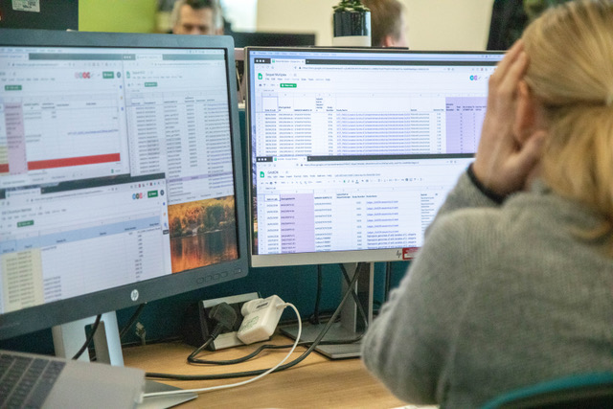
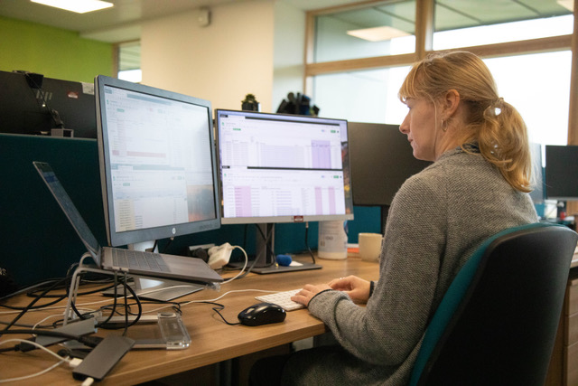
"We need a LIMS so that my full time job is not inputting info into Google Sheets"
We have gone from tracking 10s of PacBio samples per month to trying to keep on top of >35 per month. When we start processing >35 per week it will be a close call between google sheets breaking or one of the team. Place your bets...

Slide 4
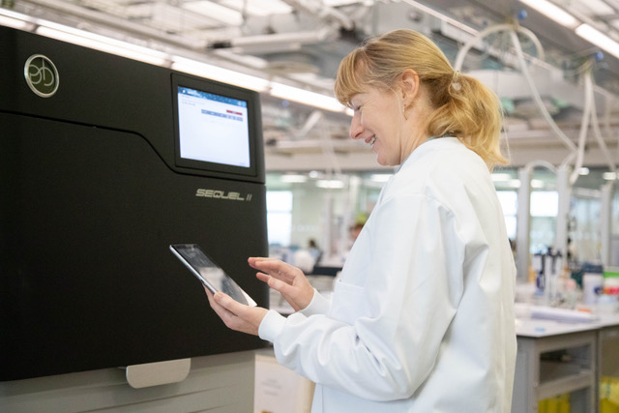
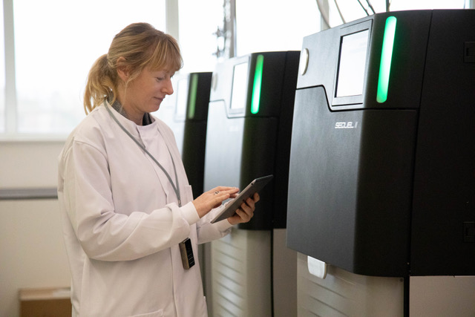
First there was Excel , then Google sheets, finally Traction

Slide 5
New Pipeline Group (NPG) | DNA Pipelines Informatics
Traction gives NPG a way to know what runs to expect on the machine
NPG can physically look at what is on the disk
Can compare that to what is in Traction to make sure they have got all the data
Need to know what, when and where
Get that information from the MLWH, which is inserted from Traction
Notes:
Keith:
What is missing from the current data gathering
Will LIMS be able to help
What Tracton delivers to NPG / faculty delivery
Buisness impare of traction for NPG
ACTIONS:
Get images that reflect his work
NPG need to know …
Need to know what, when and where
Get that information from the MLWH, which is inserted from Traction
Use the data that Traction puts into the MLWH
NPG want to know what biological material has been loaded which flowcell
NPG identiy the origin of samples which is loaded onto the oxford ONT tehnologies
Timestamps from files
And gives NPG a way to know what runs to expect on the machine
NPG can physically look at what is on the disk
Can compare that to what is in Traction to make sure they have got all the data
Currently, without Tracton
To know what the sample is currently,
Collobrate – fields in the MLWH table
Make sure the required fields
Discussed the fields in the table to make sure data NPG required was inserted
Gridion – nothing before Traction
R&D machience –
Permition – done in an ad hoc way. P gives an example of what the gridion used to be like

Slide 6



Faculty
Operations
External Partners
Notes:
Three different areas to address: operations, faculty, external partners
Operations
Need central place to track long read samples – not suitable at the moment. Need one to track
SS is wrong -> Traction right
Diagram to show operations with a LIMS that doesn’t support long read -> operation with LIMS that does
Tree of Life
Faculty
Will be able to know that the sample that went in matches the data that came out.
Have an idea of where the sample are in the workflow e.g. QC
Correlate sample with output
Know whether there is still sample material left for further analysis
Need to be able to see what is going on with their samples and need to be able to analyse the data
Karen
Picture of Tree of Life
Include stats of Tree of Life and Info
Picture to show management of data
External Partners
Do they need to use our data?
Talk to Naomi – give better idea of what they want, and how to visualise it
Natural History Musuem
Image of NHM
R&D
With LIMS tracking we will have all of the historical data e.g. method of extractions which we can correllate with the sequencing data to give us an idea of how we can improve pipelines in the future.
ACTIONS:
Speaking to Naomi – get better idea for the external partner
Get stats for Tree of Life for Faculty
Draw something up to show SS = old, Traction new

Slide 7
HOW

Slide 8
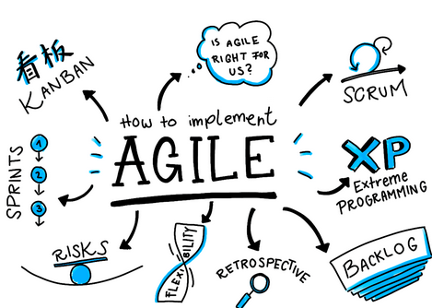
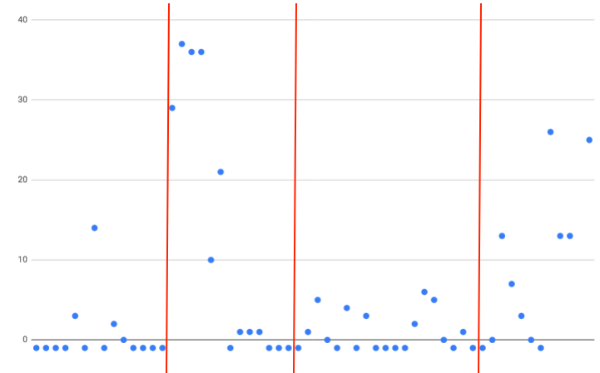
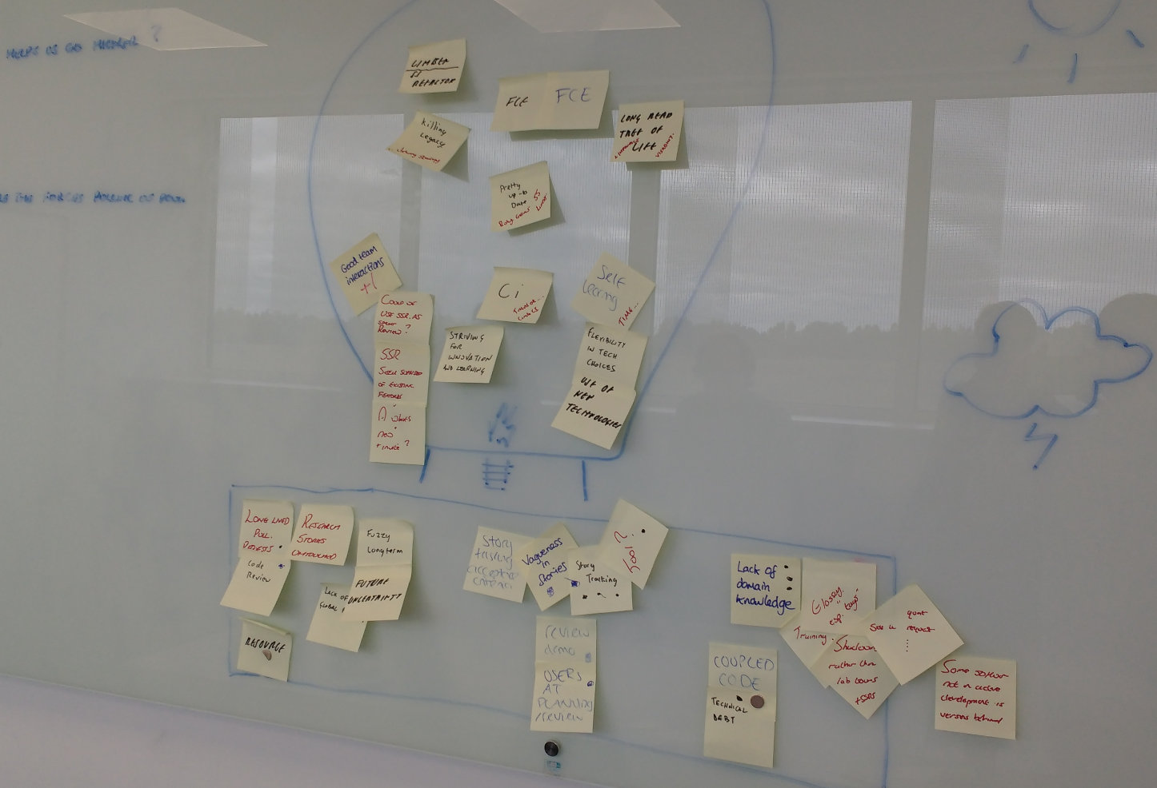
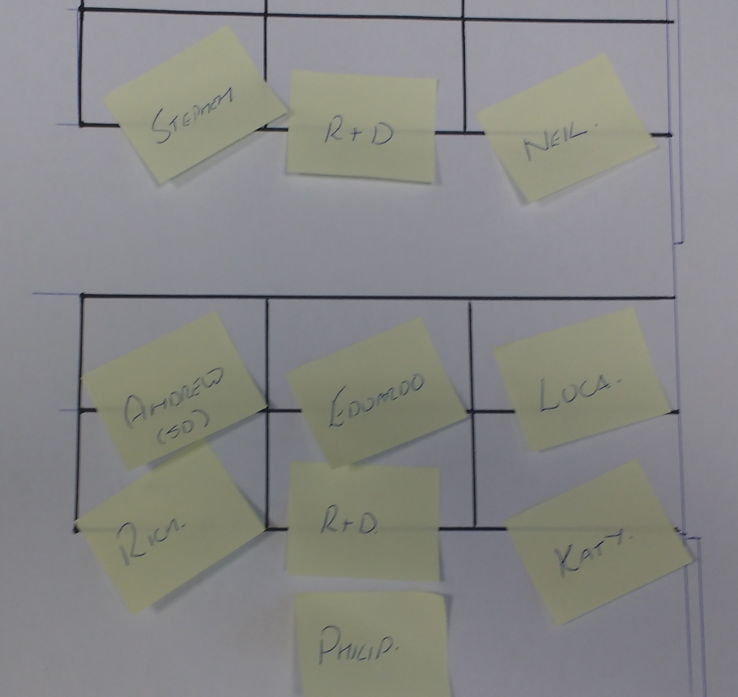

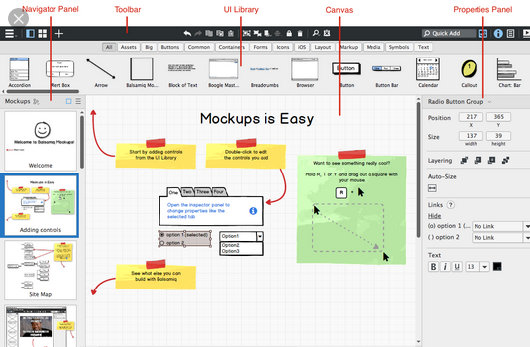
Development Process
Notes:
Agile
Sprint
Planning
Stand ups
Stories
Tasking
Prototyping
Code review
Merge
Deploy
Test
UAT
production
Lots of image of techy processes
ACTIONS:
Get pictures from Mark of stand ups

Slide 9
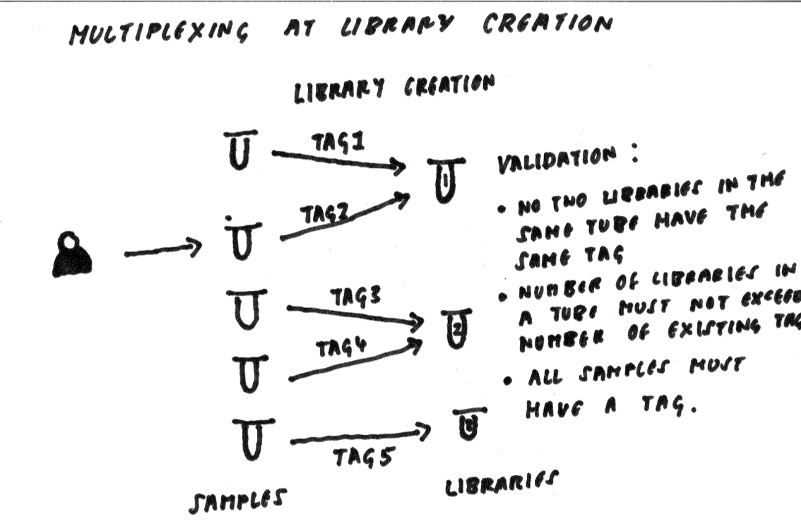
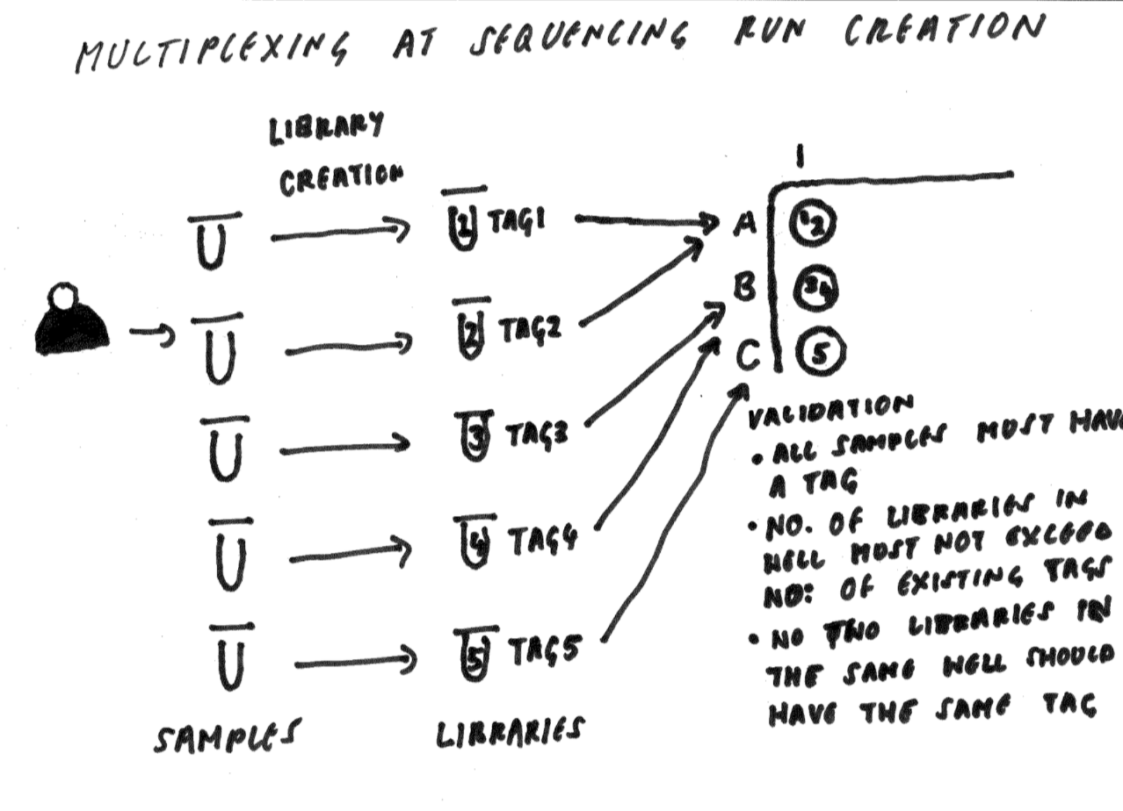
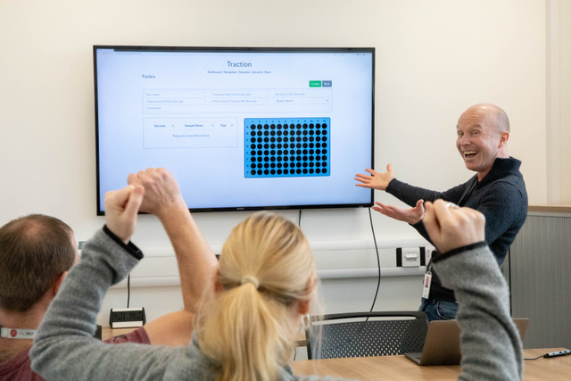
Customer Interaction
Notes:
Customer interaction
Understanding their process
Design meetings
UAT
Regular feedback
Lab walk through with software
ACTIONS:
Get picture of us in room with Karen and Craig - review
Pictures of process diagrams
Richs tracking
Picture of us testing in the

Slide 10



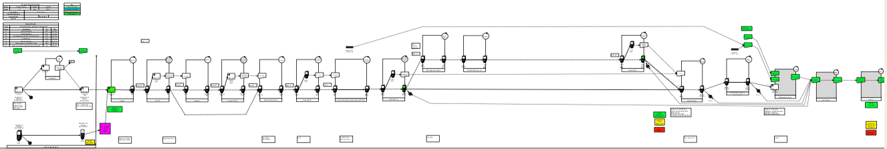
What we learnt to do better
Notes:
Internal
How we learnt to improve our software development process
Team – try to remove ambiguity
Better planning
Taskings
MVP
Slack
Communication
External
Communication
Two images
1 wrong software
2right software
Process maps - Mapping out the process
Ideal
Quote from Craig
Image of spike planning
Team improve developer process
Tasks
explicit
Driven by barcodes
From that, started to communication more and earlier
User needs
ACTIONS:
Speak to Craig about last spike meeting
Image of the multi plex

Slide 11
NOW

Slide 12

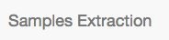


Architecture
Notes:
High level
What services Traction is currently speaking to
SS -> SE -> Traction -> WH
Picture of SS sample manifest
Picture of Sample Extraction
Picture of Traction
Picture of data
$>$s etc
ACTION:
Create high level architecture diagram
Get screenshots

Slide 13
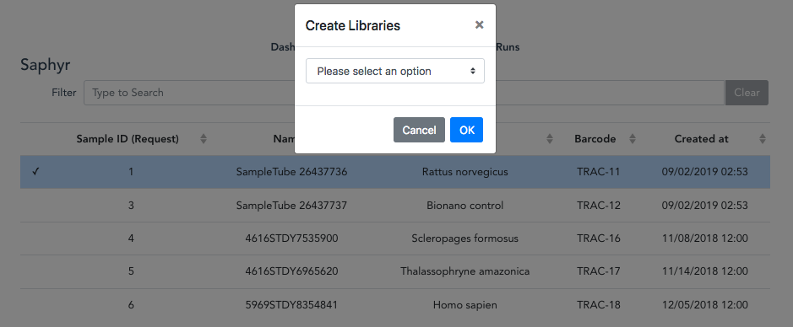
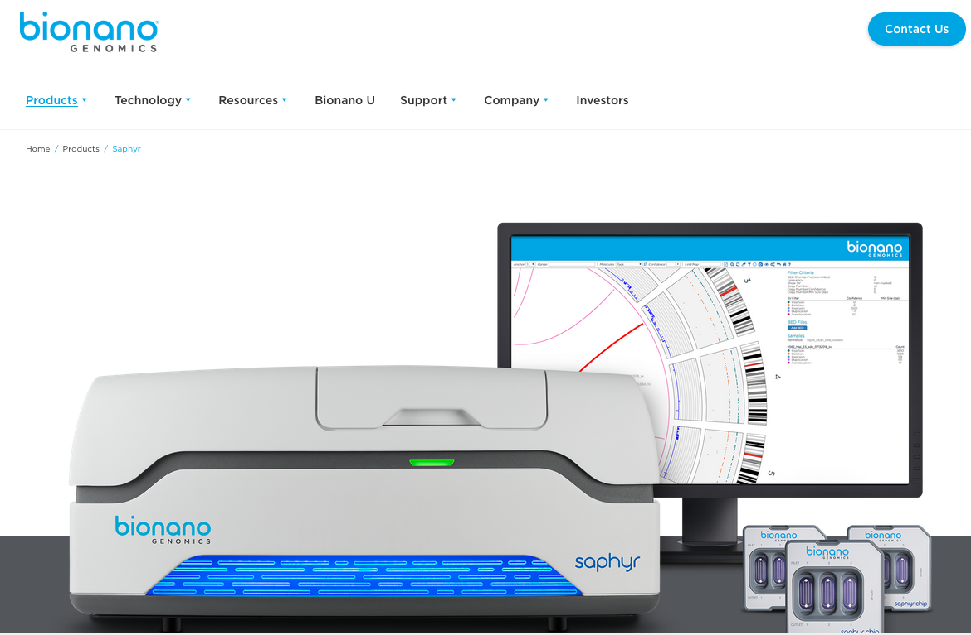
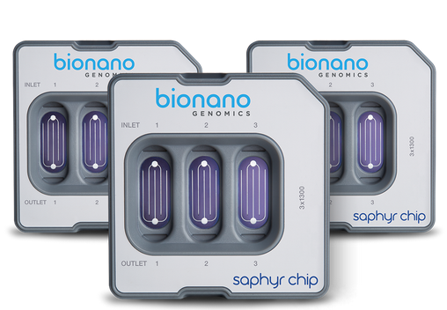
Saphyr
Notes:
Saphyr (screen shots of the below)
Went live 6 months
23 runs in Saphyr
Nothing recently because of Saphyr instrument faults
What it is …. (get from Michelle)
Reception
Library creation
Run creation
Picture of software o the Saphyr instrument
ACTION
Lots of screenshots
Picture of Saphyr instrument
Picture of Saphyr software
Get quote from Michelle about Saphyr

Slide 14
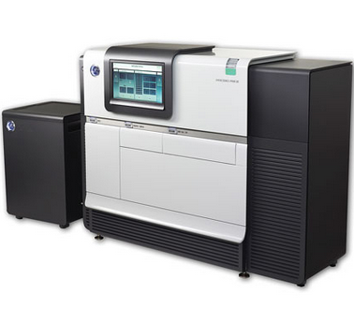
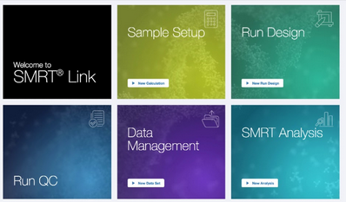
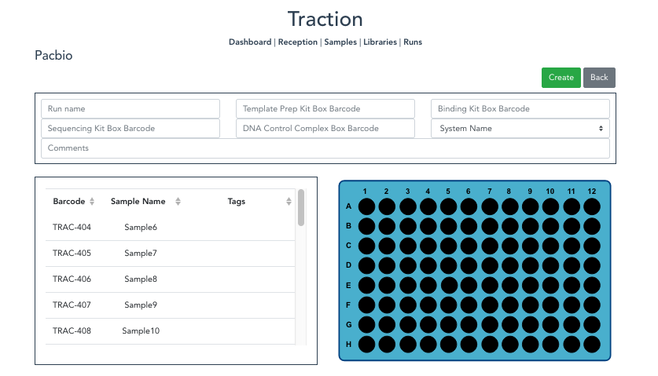
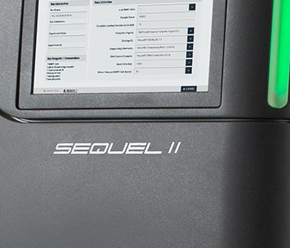
Pacbio
Notes:
Pacbio (screen shots of the below)
What it does …
Reception page
Samples page
Library creation
Run creation
Generation of sample sheet
Picture of Pacbio Instrument + SMRT link up
Live last week
First samples went in this week
Runs in before christams
ACTIONS:
Get quote from Karen about Pacbio and what it does
Get lots of screenshot
Get image of the instrument

Slide 15
COMING SOON

Slide 16

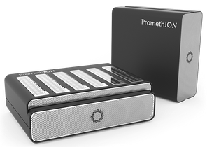

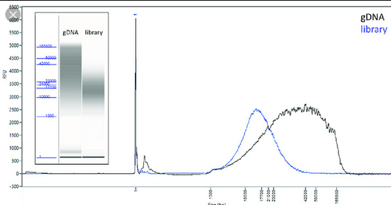
ONT and Pacbio
Notes:
ONT
Reception, library creation and runs for promethion starting in the new year – working together with the ONT
Genomics England are looking to scale up their promethion work, and are looking to collaborate with us
Pacbio multiplex – working on at the moment, expected delievery Jan
Going to add support for different instruments:
Promethion
Gridion
Includes support for extraction, reception, QC, run creation
Pacbio
Add tracking support for QC and femto pulse (images)
Add automation – important as throughput increased with the Tree of Life project. Also to automatically generate a run to export to instrument on creation
Picture of ONT logo
Picture of promethion instrument
Picture of gridion instrument
Image of femto pulse (images)
Image of automation and Tree of Life
ACTION:
Speak to Karen
Visualise QC tracking for pacbio – find out how to picture QC
Image of femto pulse (images)

Slide 17
THANK YOU
Notes:
Thank you’s to…
Long read team: Karen, Craig, Emma, Michelle, Mark
NPG
R&D
Rich
Phil
Luca
FCE support
Anyone else

